Slide 1
THEATRE AND SOCIETY Theatre Studies Level 1 Semester Two: Spring 2020

Slide 2
COURSE CONVENOR: DR VICTORIA PRICE
Victoria.Price@glasgow.ac.uk
Room 306, Gilmorehill Halls
Office hours: Mondays 1pm – 3pm
COURSE ADMINISTRATOR: ANDREW PARKER
Andrew.Parker@glasgow.ac.uk

Slide 3
OVERVIEW
Theatre and Society aims to guide the student towards a critical awareness of the multiple relationships between theatre and society, both historically and in contemporary practices.
It will encourage an understanding of some of the social, political and economic issues affecting theatre practice in Scotland and in Britain whilst also inviting comparison to practice in other countries.
The course will also open up some of the major cultural debates in contemporary theatre. The course seeks to defamiliarise students’ understanding of how theatre operates by comparing different theatre contexts separated by history and/or geography.

Slide 4
OVERVIEW
The lectures will focus on six contexts, delivered in six separate blocks of lectures – Elizabethan and Jacobean Theatre, post-1968 British Theatre, French Theatre, 20th-Century German Theatre, Verbatim and Documentary Theatre and Interculturalism – and each block will respond, in varying degrees, to three key themes: patronage and subsidy; control and restraint; audiences and makers.
The intention of this course is not to provide an overview of theatre history. Rather, it is to encourage you to think about the inter-relations between society, broadly conceived, and theatrical production and reception.

Slide 5
A deceptively straightforward question: what are the relationships between theatre and society?

Slide 6
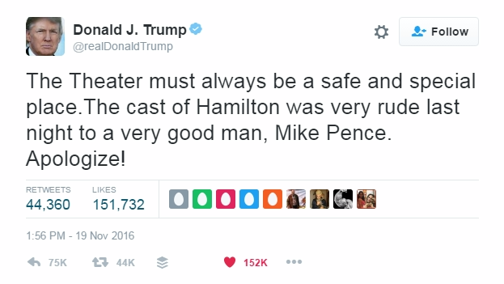
Notes:
speech from stage by Brandon Victor Dixon, who plays the US’s third vice-president, Aaron Burr, at end of performance
claim that theatre should not be involved in politics, and should even be insulated from the real world?
might read that this episode demonstrated the failure of theatre to enact an intervention in its own right: the work contained behind proscenium arch, cast had to step forward and break from it to address the audience, and Pence
but does the episode also illustrate continuing role of theatre as a public forum?

Slide 7
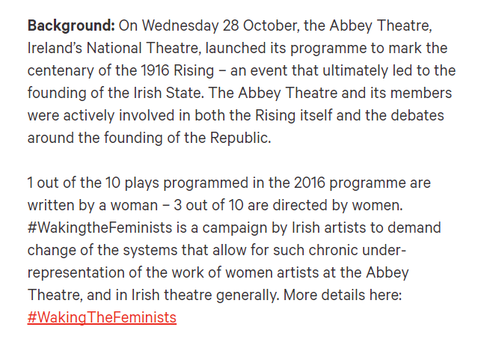

#WakingTheFeminists campaign for equality for women in Irish theatre, formed in protest against the male-dominated lineup at the Abbey in Dublin for its 2016 centenary programme. See: http://www.wakingthefeminists.org/
Notes:
produced research showing that

Slide 8

Research produced by Dr. Brenda Donohue, in collaboration with Irish Theatre Institute and the Centre for Drama, Theatre and Performance at NUI Galway found that
institutions with highest levels of Arts Council funding had worse levels of gender inequality than those in receipt of less money
gender parity not reached in any role (with the exception of costume designer)
“Women are poorly represented in the majority of key roles in the top-funded theatre organisations in Ireland.”
See: http://www.wakingthefeminists.org/wp-content/uploads/2017/08/Gender_Counts_WakingTheFeminists_2017.pdf
Notes:
produced research showing that

Slide 9
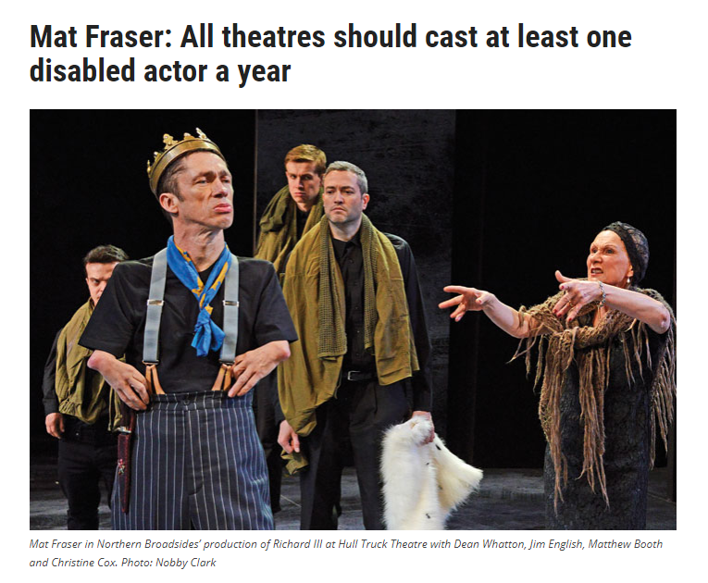
Source: https://www.thestage.co.uk/opinion/2017/mat-fraser-all-theatres-should-cast-at-least-one-disabled-actor-a-year/
Notes:
“Every theatre should commission at least one disabled -playwright, and cast at least one disabled actor a year. It would be a cultural theatrical revolution. I believe that all arts funding should hold that as a condition.”

Slide 10
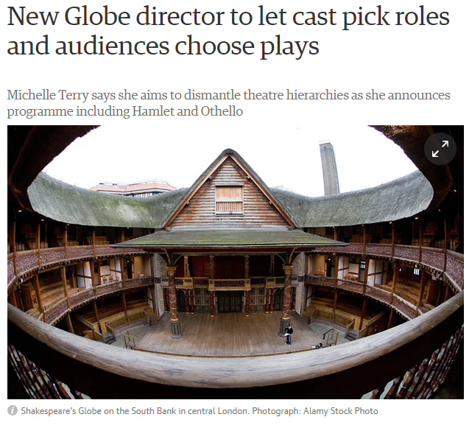
‘The new artistic director of Shakespeare’s Globe has promised to give more power to the casts and audiences of plays, saying she wants to dismantle theatre hierarchies.
Michelle Terry announced a new season opening with Hamlet and As You Like It. Eye-catchingly, none of the actors turning up for rehearsals will know which role they are taking, with the whole ensemble choosing who plays whom.
In a similar vein, when the plays The Merchant of Venice, The Taming of the Shrew and Twelfth Night go on tour, some audiences will be able to choose which one they want to see that night’
Source: https://www.theguardian.com/stage/2018/jan/04/new-globe-director-to-let-cast-pick-roles-and-audiences-choose-plays
Notes:
There will be a 50-50 gender split across the season, but at present there are no targets for other areas. “I can’t give you a policy for diversity because it is too complicated, it is too complex,” Terry said. “Actually it is about data collection and some people don’t want to tell you which socio-economic background they are from or what sexuality they are because they have fought their whole lives to not be seen like that.

Slide 11
THREE INTERCONNECTED THEMES
patronage and subsidy
control and restraint
audiences and makers

Slide 12
PATRONAGE AND SUBSIDY
patronage as a form of privilege? An exercise in power? A way of creating, enhancing or protecting status? Financial aid but also other kinds of institutional support..
subsidy as a way of extending access to theatre for a more diverse range of makers and audiences?
one contemporary example of direct subsidy might take the form of direct government funding for the arts (e.g. Arts Council Scotland/Creative Scotland) but also broader economic structures (e.g. tax relief for film production)
does public or private funding change how a work of art is received? Do we invoke or assert different standards, different expectations?

Slide 13
CONTROL AND RESTRAINT
‘to control’ as to hold in check, to regulate, to exercise power over, to prevent from growing spontaneously (or even to eliminate)
‘restraint’ as an inhibition, prevention or moderation of action, a ‘holding back’, a form of discipline (compare with ‘constraint’ as a limit or restriction, a barrier)
distinction between (external) control and (self) restraint? e.g. censorship and self-censorship?
control and restraint of form as well as content

Slide 14
AUDIENCES AND MAKERS
who gets to make and see (and study) theatre? Who is theatre made by, for and/or with? Recalling last semester’s debates, who or what is represented by theatre, and on what terms?
Is there a rigid distinction between audiences and makers, or are other more complex relationships at play?
If the work is ‘collaborative’ and/or ‘interactive’, what kind of exchange is imagined? How is that ambition reflected in the conditions of the work, or the work itself?
Does theatre attempt some kind of intervention in the world?

Slide 15
COURSE AIMS
The course Theatre and Society aims to:
guide the student towards a critical awareness of the multiple relationships between theatre and society, both historically and in contemporary practices;
encourage an understanding of some of the social, political and economic issues affecting theatre practice in Scotland and in Britain whilst also providing appropriate comparators from other countries; and,
explore some of the major cultural debates in contemporary theatre.

Slide 16
WHAT SHOULD I BE ABLE TO DO AT THE END?
On successful completion of Theatre and Society students will be able to:
recognise some of the cultural, political, institutional, and economic factors underlying the operation of different types of theatrical presentation, both in contemporary society and historically;
demonstrate an appreciation of the meaning and significance of theatre in different societies and be able to engage critically with cultural debates related to theatre;
read the secondary literature critically, and be able to identify problems clearly for discussion in seminars;
use seminars with confidence as a way of clarifying and evaluating ideas, and,
present ideas critically, clearly and coherently in academic essays, developing well-structured arguments, and observing the disciplines of referencing, footnoting and bibliography.

Slide 17
ASSESSMENTS
2000 word essay relating to the first three sections of the course (40%)
1 hour exam in the April/May diet (40%)
A mark for individual contributions to seminar discussions, presentations and practical work (20%)
There will be a full briefing on the exam in week 11. We will also offer essay surgeries to discuss essay plans and offer advice on possible research reading – come and see us!
Essay questions will be circulated and posted to Moodle by the end of week 2

Slide 18
SEMINARS
8 groups with sessions structured around presentations and discussions, alongside practical explorations
emphasis on developing your understanding of theatre as a system of cultural production, examining the connections between different historical and cultural contexts and on developing your communication skills
shift in emphasis from thinking critically through practice / as a practitioner to focusing on critical use of secondary literature through presentations and debates, using seminars to clarify and evaluate ideas; practical work linked to Documentary Theatre unit
seminars start in week 2 beginning Monday 20th January: there are no seminars this week

Slide 19
SEMINAR PRESENTATIONS
during your first seminar in week 2, you will be asked to choose two seminar topics which you will then prepare for the appropriate week in the schedule. You will work collaboratively in a small group on a 15 minute presentation and then lead a discussion/debate with everyone else in your seminar group
in your first seminar, as a group and with your tutor, you will discuss and collectively decide what makes a ‘good’ presentation and how to lead and generate debate. These criteria may be used to provide you with formative peer and tutor feedback on your presentation skills
plan ahead: once you know when are presenting, make sure that there is space in your diary to meet and work with other group members. This might mean putting off a trip home at the weekend or changing shifts at work: try to accommodate each other’s schedules.

Slide 20
SEMINARS: YOUR PARTICIPATION
The seminars are a formal assessed element of the course – please arrive punctually, and prepared to take part. If you are delivering a presentation, keep in close communication with the other people in your group.
If you are unavoidably absent through illness or some other legitimate extenuating circumstance (e.g. bereavement) you must register this absence on MyCampus before the event or no later than 24 hours after it has taken place. Out of courtesy, please also contact your tutor and keep in touch with other group members.
Communicate! If you have problems with the course or seminars, talk to me or your seminar tutors. If something is unclear or if you are unhappy on the course, we can’t help if we don’t know about it, and it is my (our) job to help.

Slide 21
THEATRE VISITS
Though going to see live theatre and performance is not a required part of Theatre and Society, we strongly recommend that you continue your habits from semester 1
Check Moodle for lists of recommended shows: the first list of suggestions is included in the course guide and will be updated as venues announce their programmes
Biggest event is TAKE ME SOMEWHERE, a festival of contemporary performance for Glasgow: https://takemesomewhere.co.uk

Slide 22
READING AND RESEARCH
Each block of lectures has a number of core play-texts and/or readings that you need to complete – these are listed in the course guide and on the Reading Lists @ Glasgow system. This gives direct access to electronic texts and other digitised excerpts. See: http://readinglists.glasgow.ac.uk/
Each lecturer will provide a bibliography of suggested further reading at the start of each unit – this material will support your research for your essays, presentations and (eventually) your exam preparation
Though we will continue to guide and support your further reading, you need to take further responsibility for your independent study as we look ahead to level 2 or further study in your home institution

Slide 23

though we have tried to select texts which we will think will be interesting and useful to you in your studies, it can be hard to know where to start in a reading list
the sheer number of works can be overwhelming, and it can be hard to tell when (or if) one text is more relevant or important than another
put simply, the library is full of books – and this is a great thing and a very confusing, potentially frustrating thing

Slide 24
Our suggestions:
start with the key performances (scripts or documentation)
choose one or two articles or chapters from books on the reading lists, and set aside some time to read slowly before moving on (focus on quality of understanding over quantity of reading)
don’t worry about the bigger picture, just concentrate on the argument or information offered point by point
plan your further reading by identifying texts that have been quoted or mentioned in the lectures (ask the lecturer if the source isn’t clear from the slides)
ask your classmates what they are reading

Slide 25
VISITING / INTERNATIONAL STUDENTS
Check your MyCampus record tomorrow morning: contact me (victoria.price@glasgow.ac.uk) to confirm place on course and to arrange a seminar group if you have not already been assigned.

Slide 26
READING FOR FIRST BLOCK OF LECTURES
Ben Jonson’s Epicoene. Available via Drama Online.
Christopher Marlowe’s Edward II. Available via Drama Online.

